Slide 1
3D-CNN,GRU,Bi-Directional RNN
Presented : Usman Ahmad

Slide 2
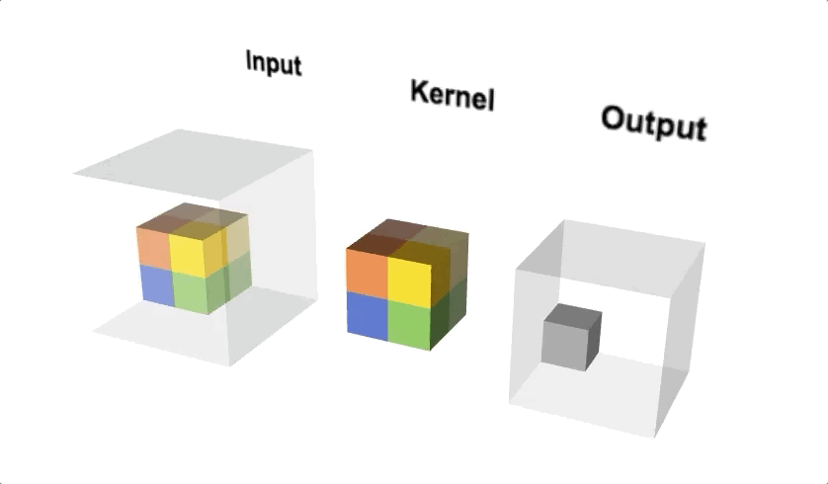
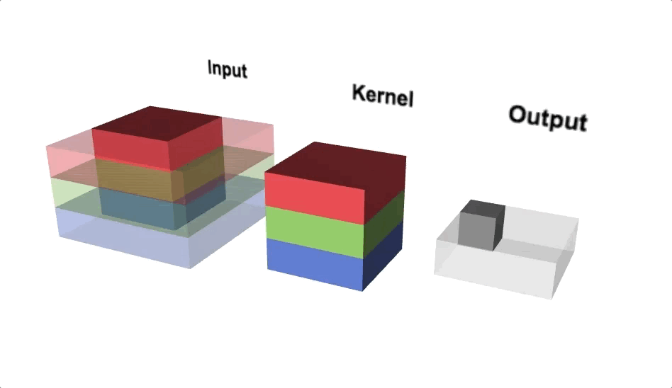
3D-CNN
A 3D Convolutional Neural Network (3D CNN) is a type of deep learning model that processes data with three dimensions (height, width, depth).
3D CNNs are designed for volumetric data, such as videos, CT scans and MRI scans.
3D CNNs can learn from both spatial and temporal dimensions, making them ideal for tasks requiring depth or motion analysis.
3d filter convolving on 3d input

Slide 3
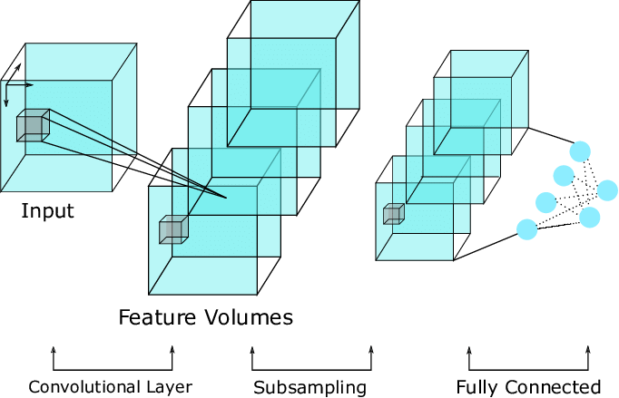
How 3D-CNN Works
3D Convolution layer:
These layers slide a 3D kernel (a cube) over the input volume to detect patterns across all three dimensions.
Pooling and Striding:
3D CNNs use 3D max-pooling layers and strides to reduce the size of the data, which helps to reduce amount of computation load.
Fully Connected Layers:
The extracted features are flattened and passed to fully connected layers for tasks like classification, regression, or detection
3D CNN model architecture

Slide 4
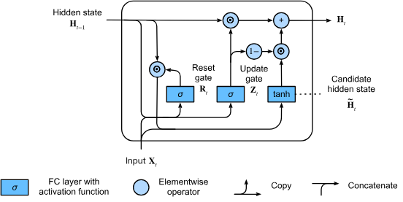
GRU
GRU stands for Gated Recurrent Unit, which is a special type of recurrent neural network (RNN) architecture.
It is similar to LSTM (Long Short-Term Memory) but has a simpler structure with fewer parameters.
The main difference between GRU and LSTM is the way they handle the memory cell state.
LSTM maintains a separate memory cell state and uses three gates: Input gate, Forget gate, and Output gate.
GRU does not have a separate memory cell. Instead, it uses a hidden state and updates it with two gates: Reset gate and Update gate.
GRU Architecture

Slide 5
How GRU Works
Step 1: Compute the Reset and Update Gates
The reset gate (r_t) and update gate (z_t​) control how much past information is forgotten or retained. These are computed using the current input (x_t​) and the previous hidden state (h_t-1​):
r_t = sigmoid(W_r * [h_t-1, x_t]) z_t = sigmoid(W_z * [h_t-1, x_t])
Step 2: Compute the Candidate Activation Vector (h_t~​)
The candidate activation vector (h_t~) is an intermediate hidden state that combines the current input and a reset version of the previous hidden state:
h_t~ = tanh(W_h * [r_t * h_t-1, x_t])

Slide 6
Con…
Step 3: Compute the New Hidden State (h_t)
The final hidden state is a balance between the previous hidden state and the candidate activation vector. This is controlled by the update gate z_t:
h_t = (1 - z_t) * h_t-1 + z_t * h_t~
The reset gate controls how much past information to forget, while the update gate decides how much new information to keep. This makes GRU efficient, as it updates its hidden state selectively without needing a separate memory cell like LSTM.

Slide 7
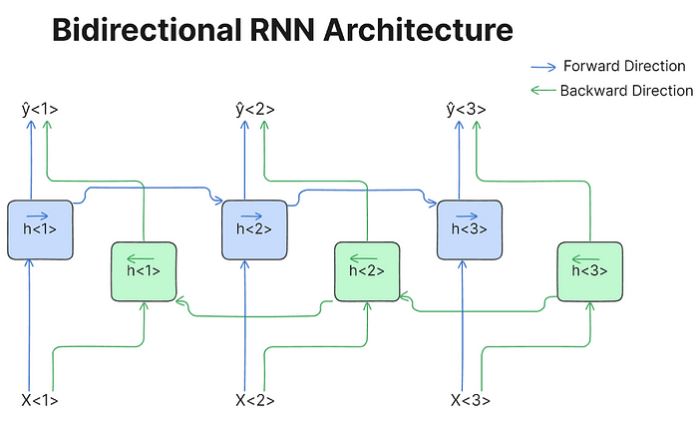
Bi-Directional RNN:
A standard RNN processes information only from past to future.it fails when current input depend on future information
A Bidirectional Recurrent Neural Network (BRNN) is an improved version of a regular RNN that processes data in both forward and backward directions.
This is useful for tasks like speech recognition, language processing, and time-series analysis, where understanding the full context improves accuracy.

Slide 8
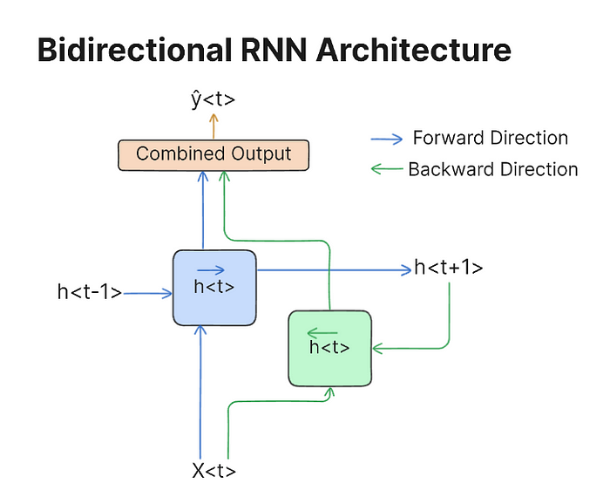
Structure
Forward and backward information flow in rnn
Forward RNN:
Processes the input sequence from t=1 to t=T.
Backward RNN:
Processes the input sequence from t=T to t=1.
Concatenation:
The outputs from the forward and backward RNNs are concatenated to form the final output at each time step.

Slide 9
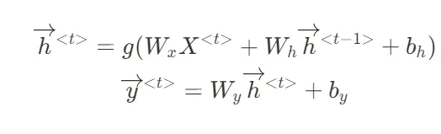
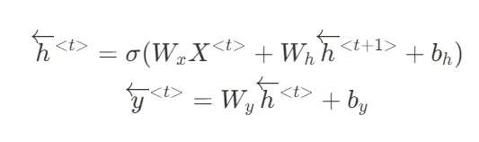
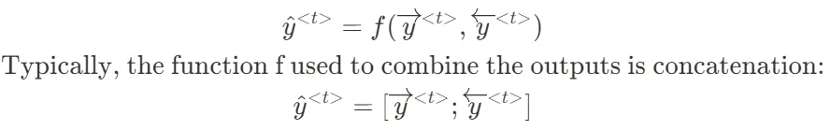
How BRNN Works
Step 1: Forward RNN Computation
Step 2: Backward RNN Computation
Step 3: Combining Both Hidden States

Slide 10


